Slide 1

Dr. D. Y. Patil Institute of Technology, Pimpri, Pune
Dr. D. Y. Patil Unitech Society’s
Department of Computer Engineering
A CEP Project Presentation for the Degree of Bachelor in Computer Engineering
Group Member Name and Roll Number:
Name: 1) Khyati Chaudhari (SCOB01)
Tanishka Dalvi (SCOB02)
Soham Malpure (SCOB13)
Shantanu Mhalaskar (SCOB19)
GUIDE:
Name: Mrs. Vasudha Phaltankar
Designation:
A.Y 2025-2026

Slide 2



Introduction
Motivation
Problem Statement
Scope & Objective
Requirement Analysis
System Architecture / Flow Diagram
Algorithm/Methods
Conclusion
Future Work
References

Slide 3

Introduction
NyaySetu: Empowering Justice Through Technology
"Expert Legal Aid for Your Rights"
What is NyaySetu?
Comprehensive legal solutions platform connecting citizens with legal expertise
Technology-driven approach making justice accessible to everyone
Web application providing free, fast legal support
Professional legal representation across multiple practice areas
Our Mission
“Provide justice through comprehensive legal support"
Eliminate geographical and economic barriers while ensuring quality legal assistance is never out of reach.
Our Vision
Create a legally informed and empowered society where:
Justice is accessible at everyone's fingertips
Legal rights are protected proactively
Communities have comprehensive legal support
Core Offering
Comprehensive legal solutions tailored to your specific needs and circumstances - from consultation to representation.

Slide 4

Motivation
Challenge 1: 📍 Limited Access
Millions in rural/underprivileged areas lack legal assistance
Lawyers concentrated in urban centers
Geographical barriers prevent access to quality representation
Leads to widespread injustice and exploitation
Challenge 2: 💰 Fear of Courts & High Costs
Indians fear the legal system due to:
⏱️ Excessive delays (cases taking years or decades)
💸 Prohibitively high legal fees (₹5,000-50,000+ per consultation)
📋 Complex, intimidating procedures and jargon
🏛️ Social stigma around legal battles
😰 Uncertainty about outcomes
Average legal case cost: ₹50,000 - ₹5,00,000+ making justice unaffordable
The Justice Gap: Why Legal Aid is Crucial
Challenge 3: 📚 Lack of Awareness
Citizens unaware of their legal rights in various situations
Don't know what legal recourses are available
Susceptible to exploitation in contracts, employment, property matters
Unable to navigate legal complexities without guidance
No trusted platform for initial legal consultation
The Gap
700+ million smartphone users but limited access to affordable, trustworthy legal guidance when they need it most.

Slide 5

Problem Statement
The Core Problem:
Millions of Indian citizens lack access to affordable, comprehensive legal aid and professional legal services, leaving them vulnerable to exploitation and unable to protect their rights.
Specific Challenges:
📍 Geographical Barriers
Legal services heavily concentrated in urban centers
Rural populations (65% of India) severely underserved
Sant Tukaram Nagar, Pimpri, Pune serves as model for accessibility
💸 Economic Constraints
Legal consultation: ₹500-5,000+ per session
Full case representation: ₹50,000-5,00,000+
Unaffordable for majority living on limited incomes
No transparent pricing or accessible options
📚 Information & Trust Gap
Lack of awareness about rights in specific situations
Don't know which lawyer specializes in their issue
No platform connecting citizens with verified legal experts
Fear of being overcharged or misguided
🗣️ Language & Complexity Barriers
Legal information primarily in English
Complex legal jargon intimidates common citizens
No simplified explanations of legal processes
⚖️ Fragmented Services
Different platforms for different legal needs
No comprehensive solution covering all legal areas
Citizens struggle to find right legal help quickly

Slide 6

Scope & Objective
PROJECT SCOPE
Platform Development
🌐 Web Application (soham-malpure.github.io/nyaysetu)
💻 Responsive Design for all devices
Key Features
🌐 Multilingual support (3 Indian languages)
🤖 AI-powered legal query resolution
📚 Comprehensive legal information database
📧 Direct contact: nyaysetu101@gmail.com | +91 8208836121
Category | Services
⚖️ Civil Law | Contract disputes, property disputes, personal injury claims
👨‍👩‍👧 Family Law | Divorce, child custody, alimony, family-related matters
🏢 Corporate Law | Business formation, contracts, compliance, IP protection
🚔 Criminal Law | Defense against charges (DUI, theft, assault), rights protection
🤕 Personal Injury | Accident victims, negligence, workplace injuries, compensation
🏠 Real Estate Law | Property transactions, disputes, leases, zoning, title issues
👔 Employment Law | Discrimination, contracts, workplace disputes, rights protection
🛂 Immigration Law | Visas, green cards, citizenship, deportation defense, appeals
💡 Intellectual Property | Copyrights, trademarks, patents, trade secrets protection

Slide 7
Scope & Objective
PROJECT OBJECTIVES
✅ Democratise Legal Aid Make quality legal assistance accessible to everyone and ensure everyone knows their rights.
✅ Simplify Legal Complexity Present complex legal information in simple, understandable language
✅ Empower Through Information AI-powered guidance on legal rights, processes, and options
✅ Enable Quick Resolution Faster access to legal guidance for timely decision-making
✅ Remove Economic Barriers Affordable consultation and free legal information
TARGET USERS
🎯 Primary: Rural citizens | Economically weaker sections | Women | Elderly 🎯 Secondary: Small business owners | Students | Accident victims | Anyone needing legal help
7

Slide 8
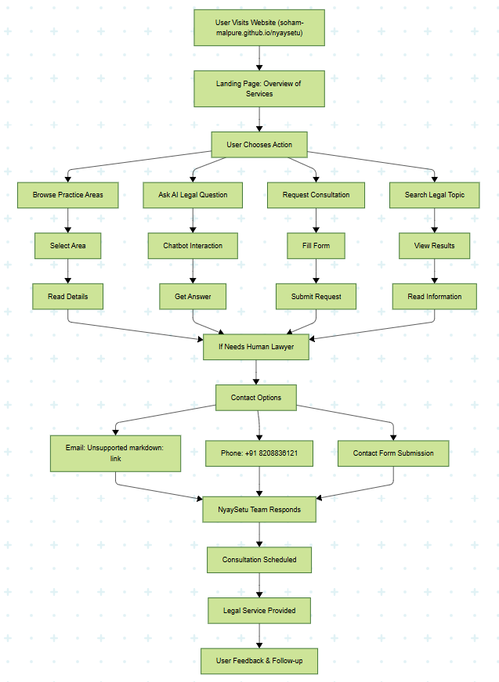
System Architecture/Flow Diagram
1️⃣ PRESENTATION LAYER
Website Interface
Voice Assistant (future)
2️⃣ APPLICATION LAYER
Query Processing Engine
Law Information
Multilingual Translation Engine
AI Chatbot Interface
3️⃣ LOGIC LAYER
AI Models (NLP)
Query Matching & Response Generation
Legal Content Recommendation Engine
Analytics & Reporting Module
8

Slide 9
Algorithm/Methods
1. SEARCH & RETRIEVAL
ALGORITHM
INPUT: User Query (text/voice)
↓
PRE-PROCESSING
Language detection
Translation if needed
Cleaning & normalization
↓
QUERY ANALYSIS
Keyword extraction
Legal domain classification
Intent identification
↓
DATABASE SEARCH
Full-text search (exact matches)
Semantic search (conceptual matches)
↓
RELEVANCE SCORING
Rank by accuracy, completeness,
context
↓
OUTPUT: Top 3-5 relevant results with citations
2. TECHNICAL REQUIREMENTS
Backend Infrastructure: Cloud hosting (GitHub Pages currently)
AI Chatbot: Custom-trained on legal queries
Frontend: HTML5, CSS3,
Communications: Email integration: nyaysetu101@gmail.com,
Phone system: +91 8208836121,
Contact forms with validation
9

Slide 10
Future Work
🏛️ INTEGRATION WITH GOVERNMENT e-COURTS
📝 Online case filing & documentation
📊 Real-time case status tracking
🎥 Virtual hearing participation
📎 Digital evidence submission
💳 Court fee payment integration
🤝 PARTNERSHIPS WITH LAW FIRMS & NGOs
Network Expansion:
Pro-bono legal services
Specialized advice in niche areas
Legal representation for deserving cases
Workshops & legal awareness camps
Partners:
Legal aid NGOs
Corporate law firms (CSR initiatives)
Law school clinics
🎤 VOICE ASSISTANT SUPPORT
Features:
Voice commands in multiple Indian languages
Natural conversation flow with AI
Hands-free operation
Benefits:
♿ Accessibility for visually impaired
📚 Support for low-literacy users
👴 Easier for elderly users
10

Slide 11
Conclusion
NyaySetu is a transformative mobile application addressing the critical gap in legal accessibility in India through innovative AI, multilingual support, and user-centered design.
KEY ACHIEVEMENTS
Designed comprehensive legal aid platform covering major Indian laws Implemented AI-powered query resolution system
Enabled multilingual support breaking language barriers
Focused on underserved populations (rural, economically weaker, women, elderly)
IMPACT SUMMARY
Individual Level: Empowered citizens with legal knowledge & confidence Community Level: Reduced legal illiteracy & preventable disputes Societal Level: Contributing to a more just & equitable legal system
11

Slide 12
References
GOVERNMENT RESOURCES
National Legal Services Authority (NALSA) - www.nalsa.gov.in
eCourts Services India - www.ecourts.gov.in
Department of Justice, Ministry of Law and Justice
India Code - Legislative Department
RESEARCH & ARTICLES
"Access to Justice in India: An Overview" - Journal of Legal Studies
"Digital Transformation in Legal Services" - Tech Law
Journal
"AI in Legal Technology: Applications and Ethics"
Studies on legal literacy in rural India
COMPARATIVE ANALYSIS
LawRato, MyAdvo, and other
legal tech platforms
International legal aid applications
Government's UMANG app - citizen services integration
12

Slide 13



